Slide 1
Dockers & Kubernetes
Docker Volumes and Networks

Slide 2
Session Agenda
Need for Docker storage
Types of Storage in Docker
Volumes
Bind Mount
Tmpfs
How to create containers with all the above storage options
Options of Docker networks
How to configure the container to use various network plugins
How to connect a running container to a network

Slide 3
Docker Storage
If any data is created inside a particular container, it is going to be stored in the R/W layer of the container.
As long as the container is not deleted, data is there.
But if the container is deleted then all the data it is holding is going to be deleted.
To deploy a stateful application, the data should persist beyond the life of a container which can be achieved using storage.

Slide 4
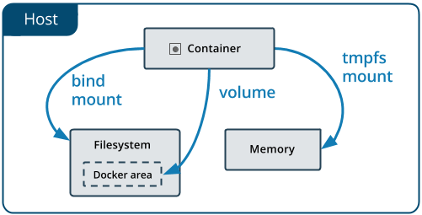
Docker Storage
tmpfs mounts are stored in the host system’s memory only, and are never written to the host system’s filesystem.
Bind mounts may be stored anywhere on the host system
Volumes are stored in a part of the host filesystem which is managed by Docker

Slide 5
tmpfs mounts
tmpfs mount is temporary, and only persisted in the host memory.
This is useful to temporarily store sensitive files that you don’t want to persist in either the host or the container writable layer.
Limitations of tmpfs mounts:
Unlike volumes and bind mounts, you can’t share tmpfs mounts between containers.
This functionality is only available if you’re running Docker on Linux.

Slide 6
tmpfs mounts
Usage:
docker run -d -it --name tmptest --mounttype=tmpfs, destination=/app nginx:latest
docker run -d -it --name tmptest --tmpfs /app nginx:latest

Slide 7
Bind mounts
The data can be stored anywhere on the host file system.
Non-docker processes running on the “docker engine host” can modify them.
Used for sharing configuration files from the host machine to the container.
Drawback:
Can’t use Docker CLI commands to directly manage bind mounts.

Slide 8
Bind mounts
Usage:
docker run -d -it --name devtest --mount type=bind, source="$(pwd)"/target, target=/app nginx:latest
docker run -d -it --name devtest -v "$ (pwd)"/target:/app nginx:latest

Slide 9
volumes
Volumes are easier to back up or migrate than bind mounts.
Can manage volumes using Docker CLI commands or the Docker API.
Volumes work on both Linux and Windows containers.
Volumes can be more safely shared among multiple containers.
Volume drivers let you store volumes on remote hosts or cloud providers, to encrypt the contents of volumes, or to add other functionality.

Slide 10
volumes
Usage:
docker volume create my-vol
docker volume ls
docker run -d --name devtest --mount source=myvol2, target=/app nginx:latest
docker run -d --name devtest -v myvol2:/app nginx:latest

Slide 11
Docker Network
Docker’s networking subsystem is pluggable, using drivers. Inbuilt networks that comes with Docker are:
Bridge : used when your applications run in standalone containers that need to communicate.
host: used to remove network isolation between the container and the Docker host.
overlay: used to connect multiple Docker daemons together.
none: to isolate the containers from external communication.

Slide 12
Bridge Network
When we start Docker daemon, it creates a default bridge network called bridge
We can modify DOCKER_OPTS in docker configuration file to specify that daemon should use the other network
To create a bridge network
docker network create --driver bridge alpine-net
To connect a container to a network on run,
docker run --name my_container --network alpine-net

Slide 13
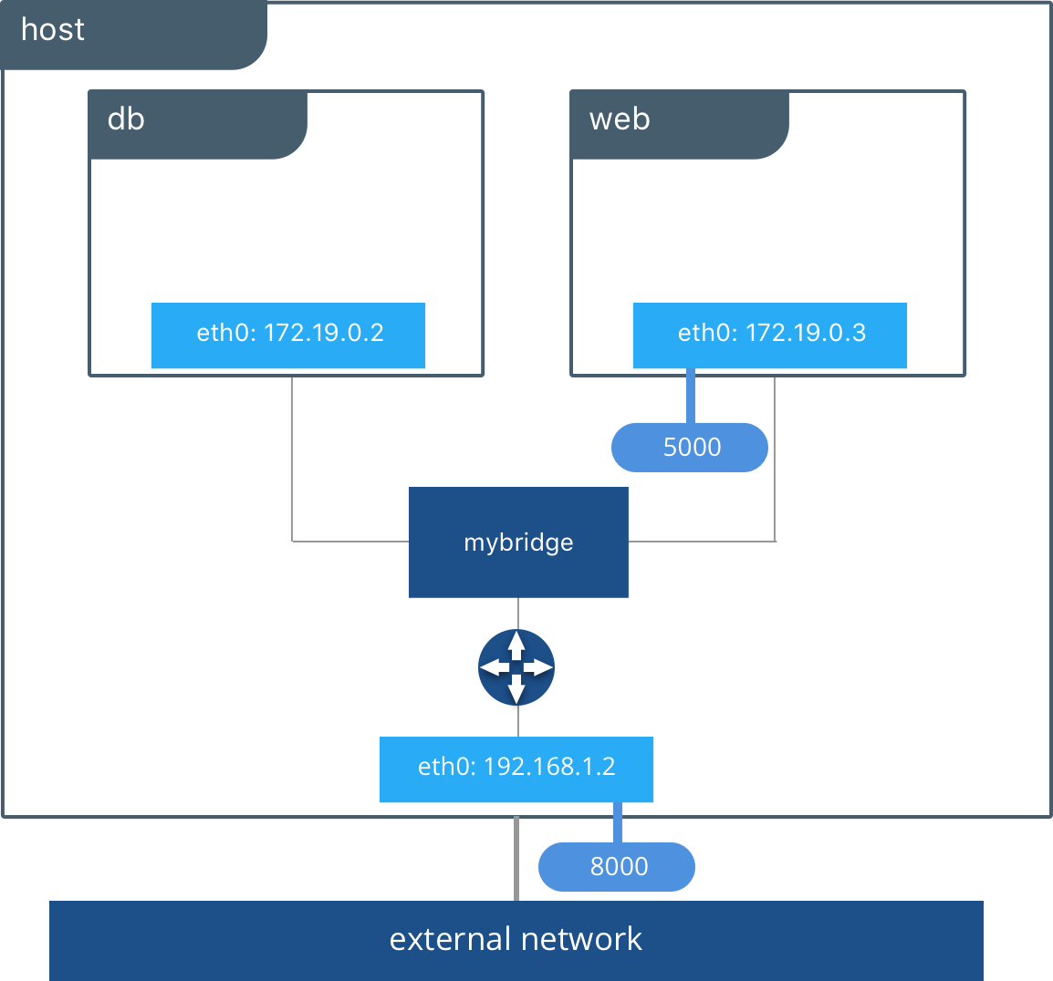

Slide 14
Host Network
In this network, the container’s network stack is not isolated from the Docker host
The container does not get its own IP-address allocated
Useful to optimize performance, and in situations where a container needs to handle a large range of ports
Host networking driver only works on Linux hosts
To add a container to host network,
docker run -dit --name my_alpine –network host alpine

Slide 15
None
Containers are not attached to any network and do not have any access to the external network or other containers.
Container lacks an external network interface. It does, however, receive a loopback interface.
Useful in case of testing containers, staging a container for a later network connection, and also for containers with no need for external communication.
To disable the networking stack on container
docker run -dit --network none --name no-net-alpine
alpine:latest

Slide 16
Overlay Network
Overlay network is used to connect the containers on multiple docker daemon hosts.
To create a overlay network:
docker network create --driver=overlay --attachable test-net
To connect a container to the overlay network:
docker run -dit --name nginx1 --network test-net -p 80:80 nginx

Slide 17
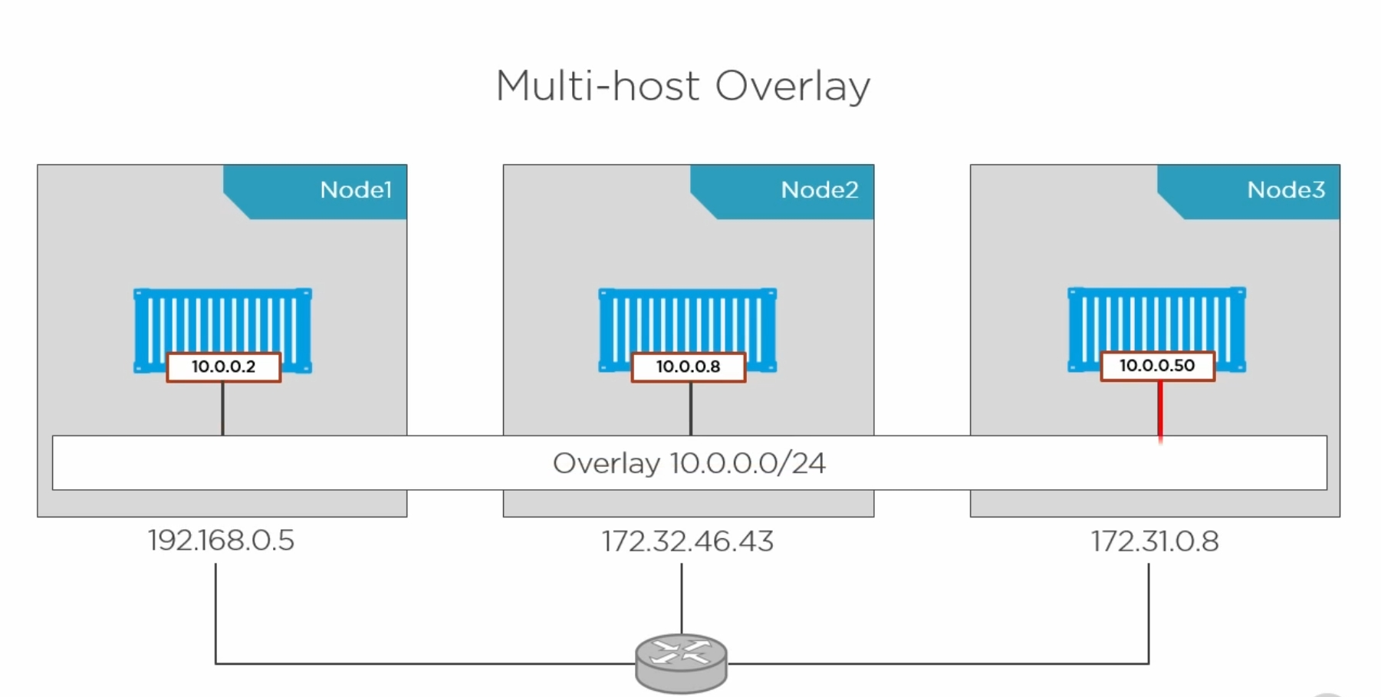

Slide 18
Network summary
User-defined bridge networks are best when you need multiple containers to communicate on the same Docker host.
Host networks are best when the network stack should not be isolated from the Docker host, but you want other aspects of the container to be isolated.
Overlay networks are best when you need containers running on different Docker hosts to communicate, or when multiple applications work together using swarm services.
Third-party network plugins allow you to integrate Docker with specialized network stacks. Various third party plugins available are: Calico, Weave, Cilium etc

Slide 19
Useful links
https://docs.docker.com/network/
https://docs.docker.com/storage/volumes/
Katacoda courses related to docker networks:
https://www.katacoda.com/courses/docker/5
https://www.katacoda.com/courses/docker/networking-intro
Katacoda courses related to docker volumes:
https://www.katacoda.com/courses/docker/persisting-data
https://www.katacoda.com/courses/docker/8

Slide 20
Thank you!

